Slide 1
SWEHB Multiver Graphics

Slide 2

Header Banners – Other Versions
Manage banner images and then save the image as a jpeg file. Copy to Confluence.
Content based on NPR7150.2A
Content based on NPR7150.2B
Content based on NPR7150.2C

Slide 3
Header Banners for SWEHBVC
Manage banner images and then save the image as a jpeg file. Copy to Confluence.
Content based on NPR7150.2A
Content based on NPR7150.2C
DRAFT
Content based on NPR7150.2A
Content based on NPR7150.2C

Slide 4
Header Banners for SWEHBVD
Manage banner images and then save the image as a jpeg file. Copy to Confluence.
Content based on NPR7150.2A
Content based on NPR7150.2D
Saved as SWEHBVD_banner.jpg
DRAFT
Content based on NPR7150.2A
Content based on NPR7150.2D
Saved as SWEHBVD_draft.jpg

Slide 5
Header Banners for SWEHBVE
Manage banner images and then save the image as a jpeg file. Copy to Confluence.
Content based on NPR7150.2A
Content based on NPR7150.2E
Saved as “SWEHBVE_banner.jpg”
DRAFT
Content based on NPR7150.2A
Content based on NPR7150.2E
Saved as “SWEHBVE_draft.jpg”

Slide 6
Header Banners Beyond SWEHBVD
Manage banner images and then save the image as a jpeg file. Copy to Confluence.
Content based on NPR7150.2A
Content based on NPR7150.2D
Saved as SWEHBVD_banner.jpg
DRAFT
Content based on NPR7150.2A
Content based on NPR7150.2D
Saved as SWEHBVD_draft.jpg

Slide 7
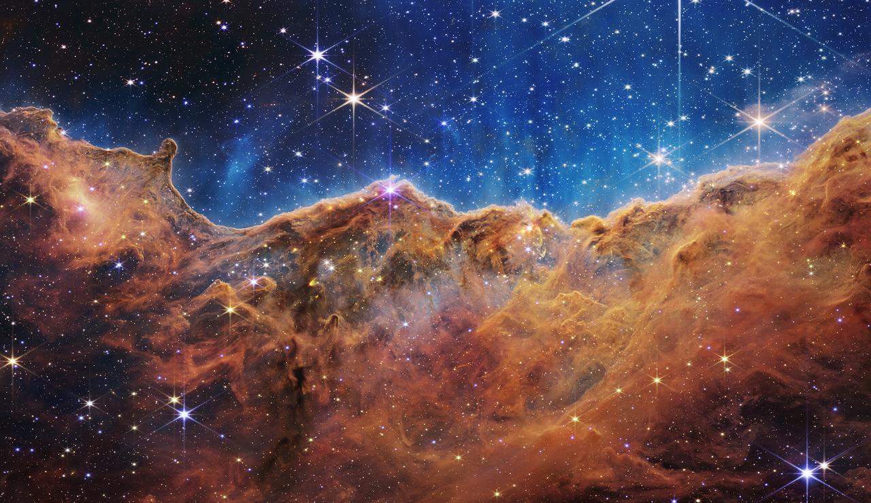
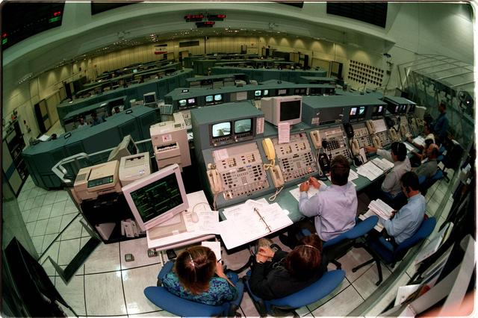
Based on NASA Images
NASA Software Engineering and Assurance Handbook
Based on NPR 7150.2D
carina_nebula
NASA Software Engineering and Assurance Handbook
Based on NPR 7150.2D
NASA Software Engineering and Assurance Handbook
Based on NPR 7150.2D
NASA Software Engineering and Assurance Handbook
Based on NPR 7150.2D

Slide 8



Based on Digital Background Images
From general search on:
Digital Programming Images
NASA Software Engineering and Assurance Handbook
Based on NPR 7150.2D
NASA Software Engineering and Assurance Handbook
Based on NPR 7150.2D
NASA Software Engineering Handbook
Based on NPR 7150.2D
NASA Software Engineering and Assurance Handbook
Based on NPR 7150.2D
NASA Software Engineering and Assurance Handbook
Based on NPR 7150.2D

Slide 9



NASA Software Engineering and Assurance Handbook
Based on NPR 7150.2D
https://pixabay.com/images/search/programming/

Slide 10
Scratchpad Area For Building Images

Slide 11

Scratchpad
NASA Software Engineering and Assurance Handbook
Based on NPR 7150.2D
https://pixabay.com/photos/cyber-glasses-virtual-virtual-world-1938449/

Slide 12
Scratchpad
NASA Software Engineering and Assurance Handbook
Based on NPR 7150.2D
KSC-98pc969
KENNEDY SPACE CENTER, FLA. -- In Firing Room 1 at KSC

